Slide 1

Matt Haines
@beardedinventor
Electric Imp
(http://hyperboleandahalf.blogspot.com/2010/06/this-is-why-ill-never-be-adult.html)

Slide 2
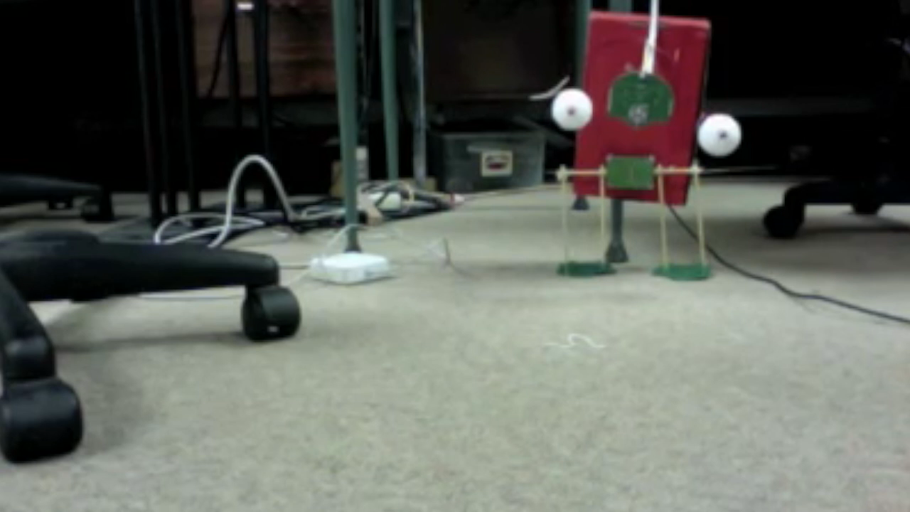

Slide 3
A few of my favourite Things*
Arduino, Netduino, Espruino, Pinocc.io, Spark.io, Electric Imp, Tessel, Light Blue Bean, Raspberry Pi, Beagle Bone Black, Galileo, Edison
*There are MANY more things

Slide 4
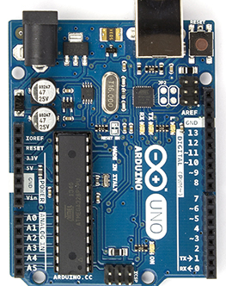
Arduino
Huge community
Many form factors
Open Source
Programmed in Processing / C
Arduino IDE
$10-$80
Depending on quality, form factor, features, etc
WiFi, Cellular, Bluetooth shields and libraries available
arduino.cc

Slide 5
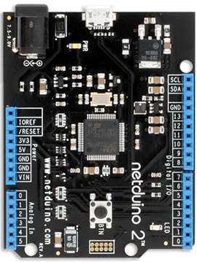
Netduino
.NET Arduino
(same pinout)
Programmed in C#
Visual Studio
$35 / $60
Netduino / Netduino Plus
Ethernet on Netduino Plus
netduino.com

Slide 6
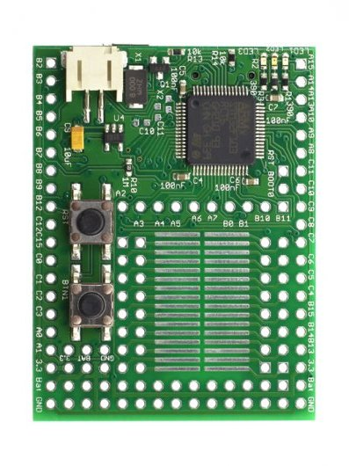
Espruino
JS development board
Open Source
Programmed with JS
Browser Based IDE
$40
Drivers for CC3000 (WiFi)
espruino.com

Slide 7
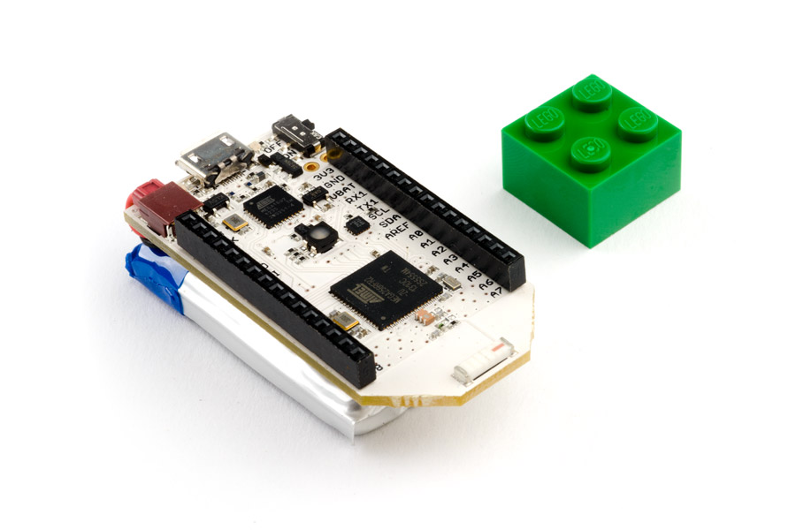
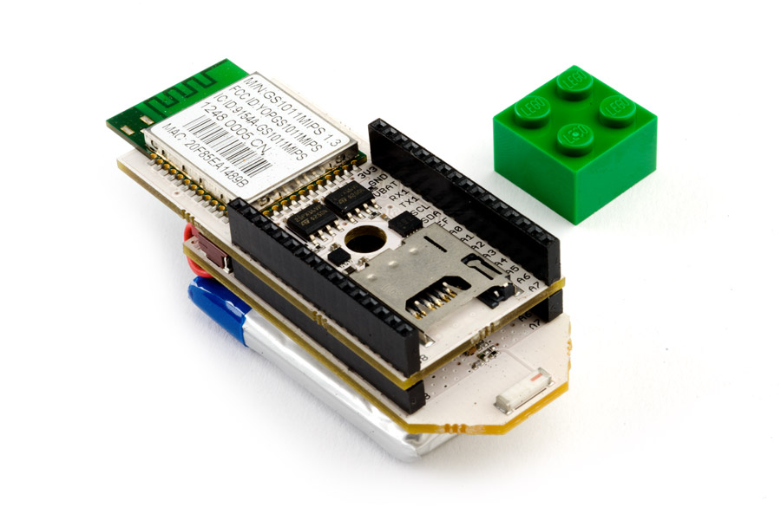
Pinocc.io
Mesh Networking!
Open Source
Two programming options:
Processing + Arduino IDE
ScoutScript + Online IDE
$60 / $140
Local Mesh / WiFi Gateway
pinocc.io

Slide 8
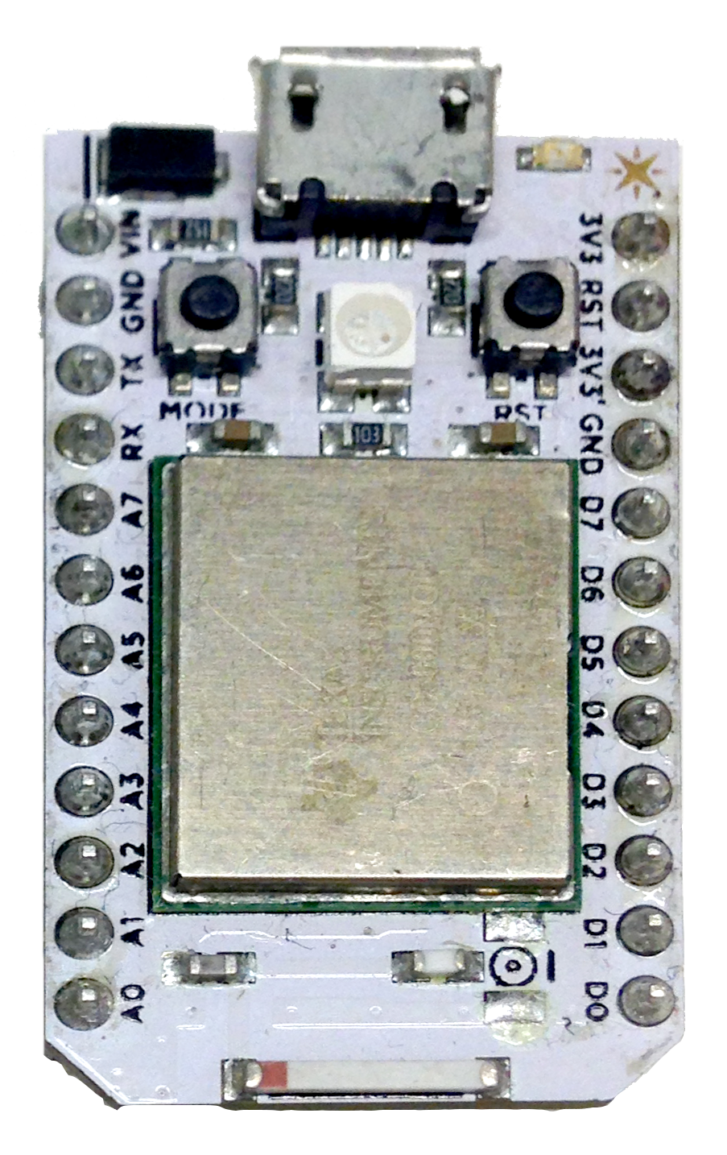
Spark IO
Arduino-based IoT Platform
Open Source
Programmed in Processing / C
Programmed in Spark Build
Browser based
$40
CC3000 (WiFi)
spark.io

Slide 9
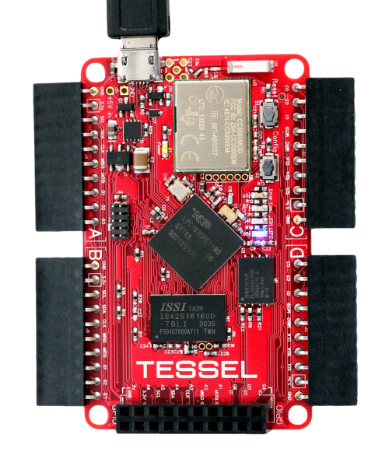
Tessel
Node.js dev board
Open Source
Programmed with JS
Command line interface
$75
CC3000 (WiFi)
tessel.io

Slide 10
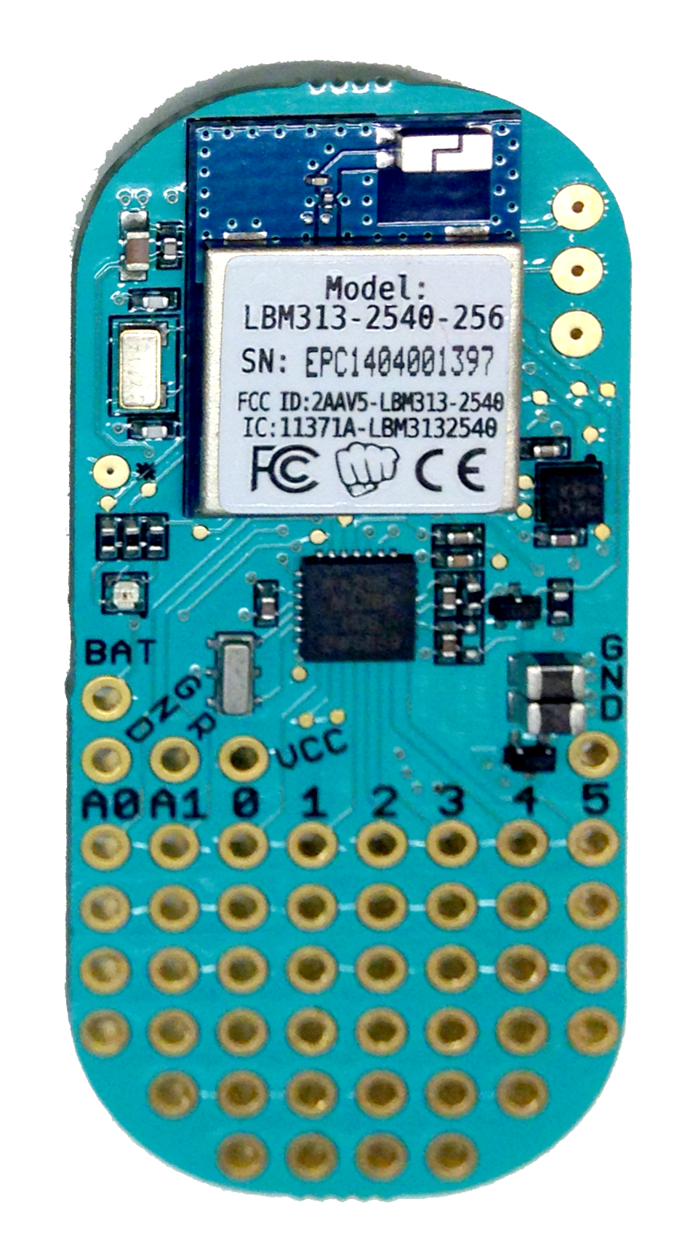
Light Blue Bean
Arduino-based BLE Dev Board
Programmed with Processing / C
Built in functionality accessible through iOS and Android libraries
$30
LBM313 BLE Module
punchthrough.com

Slide 11
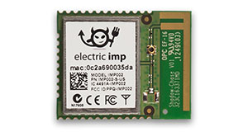
Electric Imp
IoT Platform
Programmed in Squirrel
Programmed in Electric Imp IDE
Browser based
$40
BCM43362 (WiFi)
electricimp.com

Slide 12
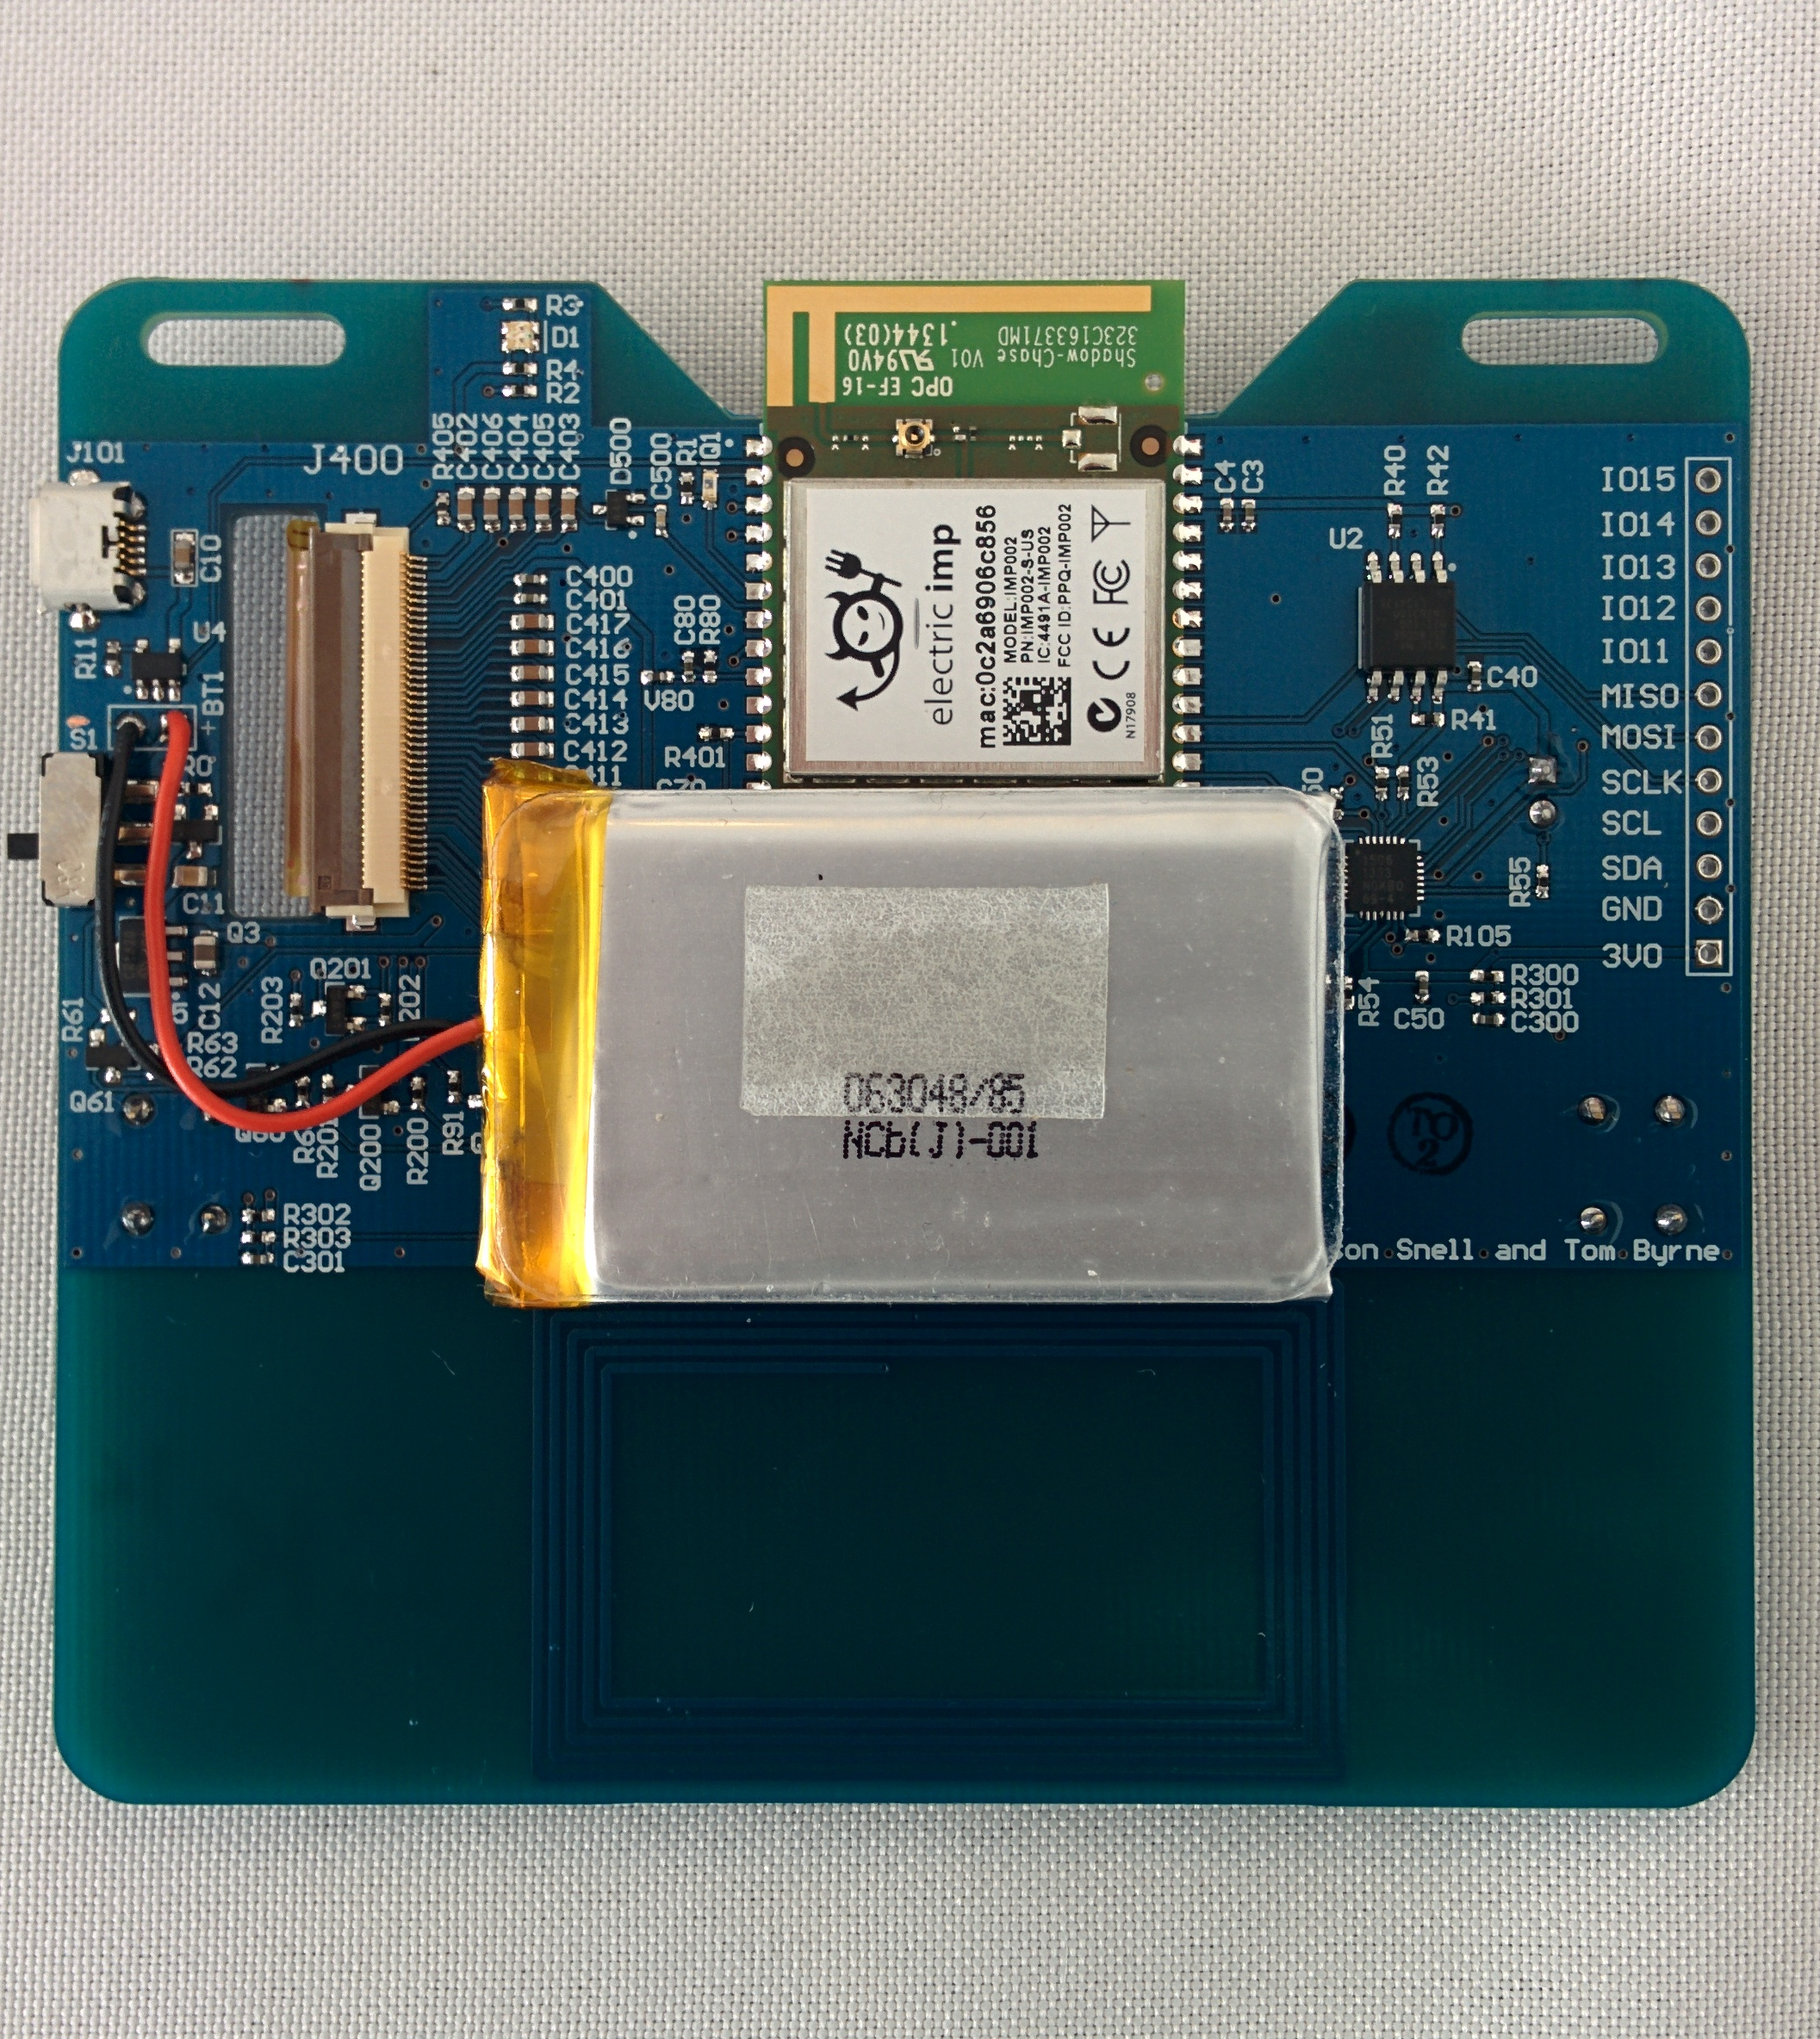
So what’s around your neck?
Imp-powered badge
NFC, epaper, temp, battery level, 2x buttons, LEDs, battery level, …
SPI, I2C, & 5 IOs

Slide 13
RPi, BBB, Galileo, Edison, …
Small linux computers
Can be programmed in a number of languages (Python, Node.js, and Processing are common)
Typically much more powerful (and complex, and expensive) than microcontroller platforms
If you can do it in Linux, you can probably do it on these boards.
raspberrypi.org | beagleboard.org | intel.com/galileo | intel.com/edison

Slide 14


Slide 15
Demo Time!
what you’re all probably here for…

